Slide 1
AGS
P:1e-5

Slide 2
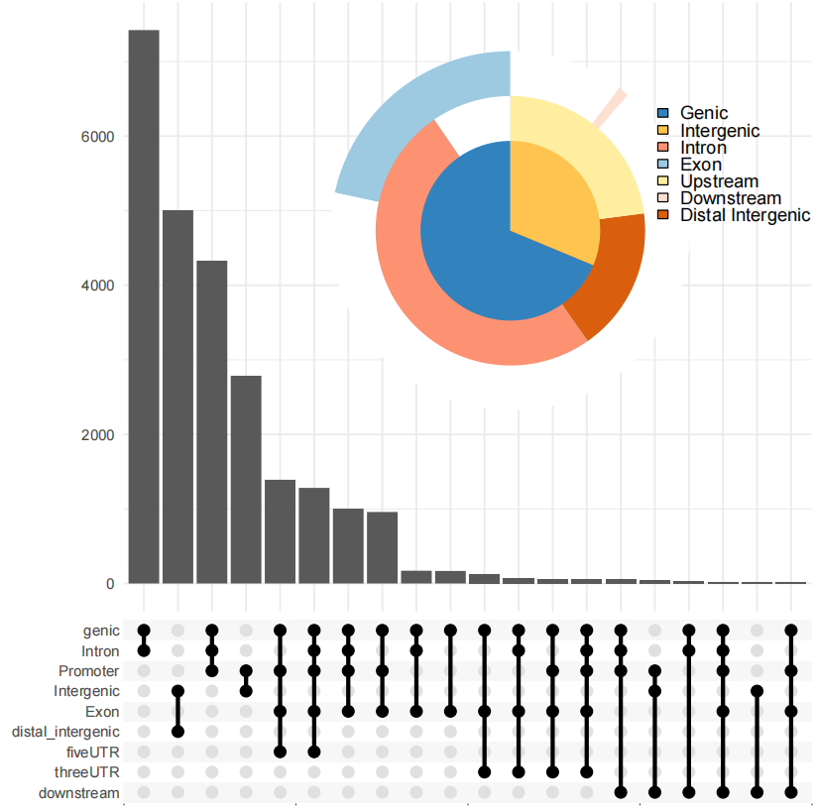
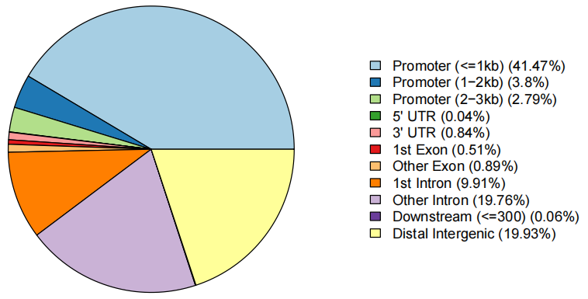
AGS

Slide 3
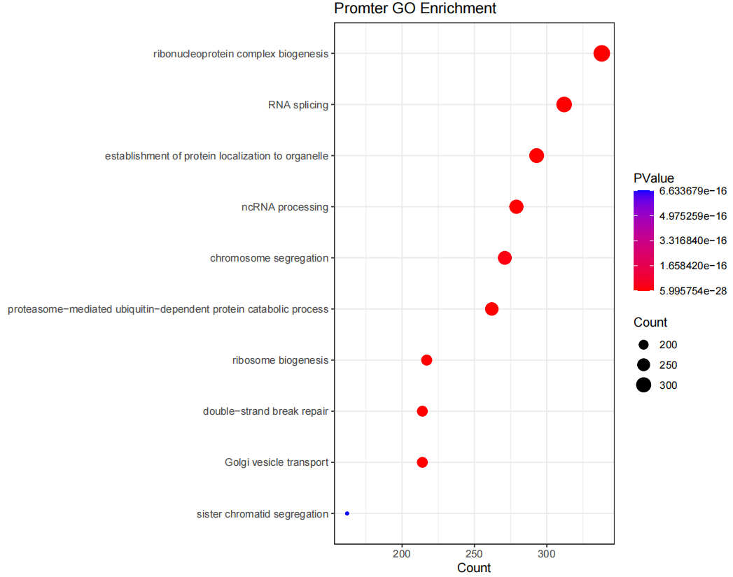
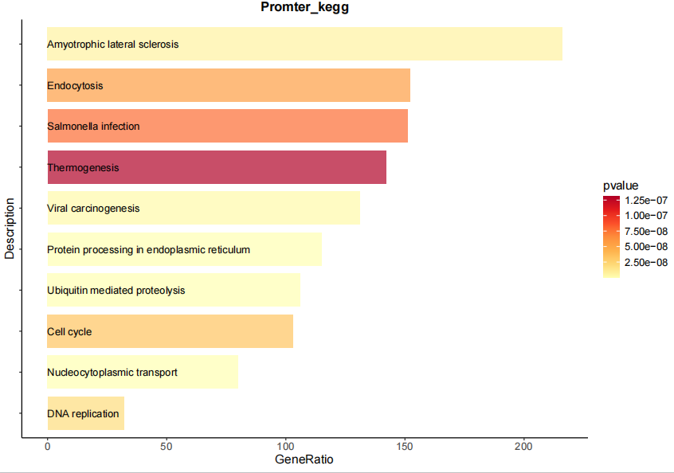
AGS

Slide 4
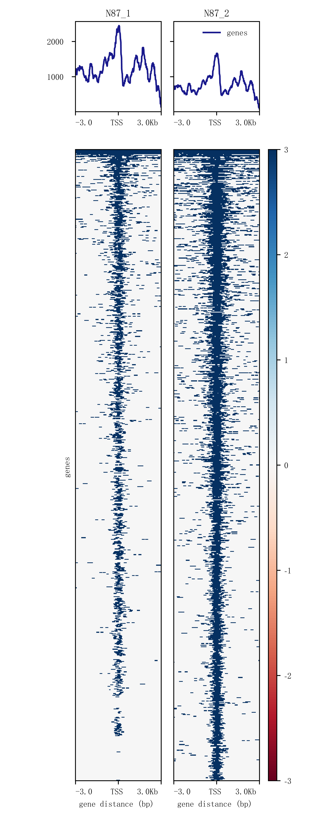
N87
P:1e-5
P:1e-4
P:1e-3

Slide 5
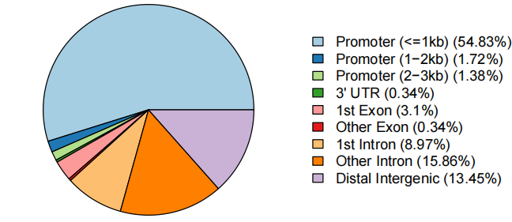
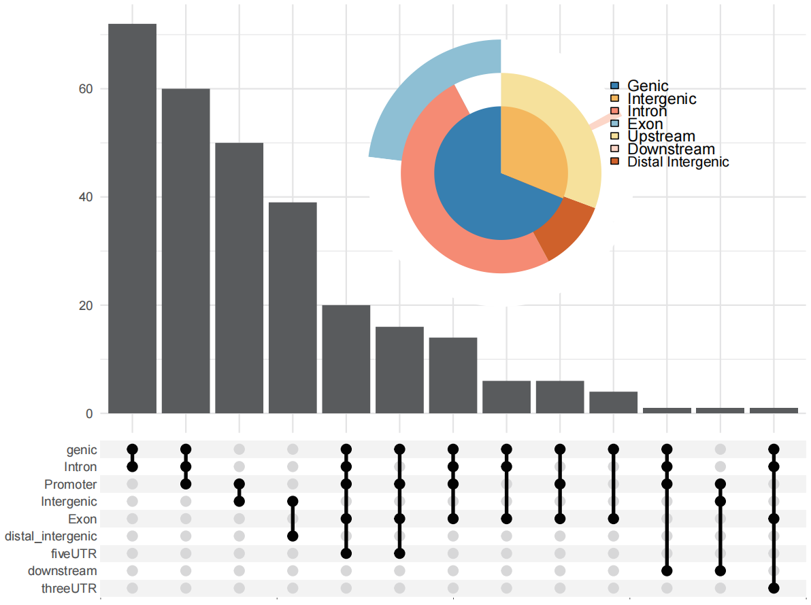
N87

Slide 6
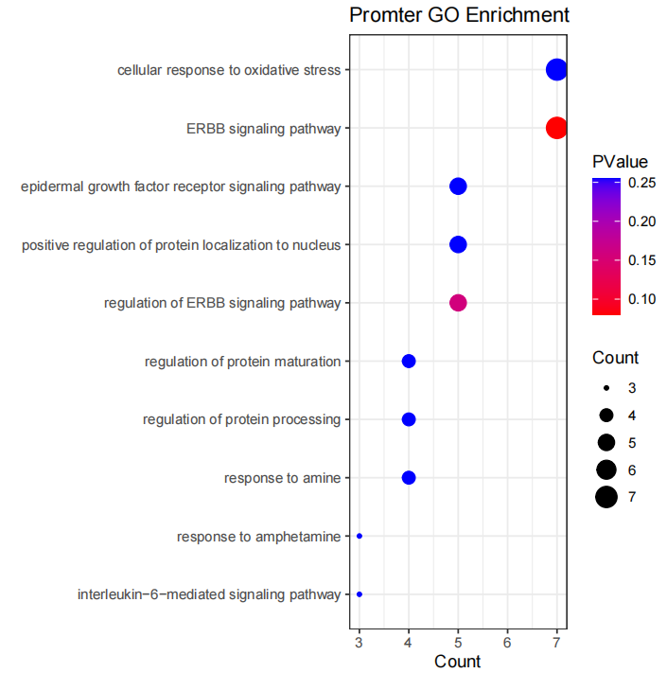
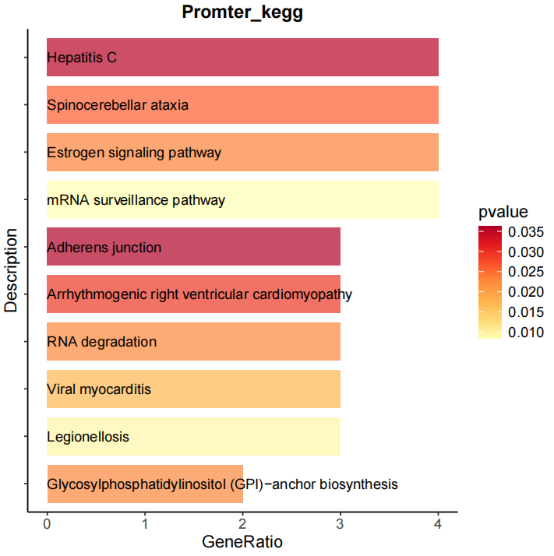
N87

Slide 7
merge
reads数量比对
sample | pairs | duplicates | rmdup | rmduped_rate
AGS1 | 17339714 | 27889242 | 6790186 | 19.58%
AGS2 | 20472962 | 27795522 | 13150402 | 32.12%
N87_1 | 4561975 | 8956546 | 167404 | 1.83%
N87_2 | 7029122 | 13653046 | 405198 | 2.88%

Slide 8
merge

Slide 9
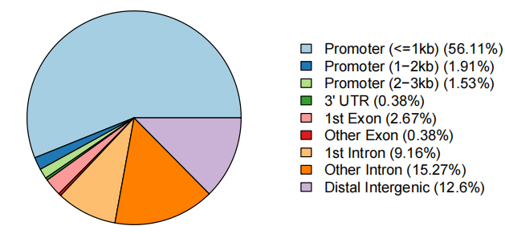
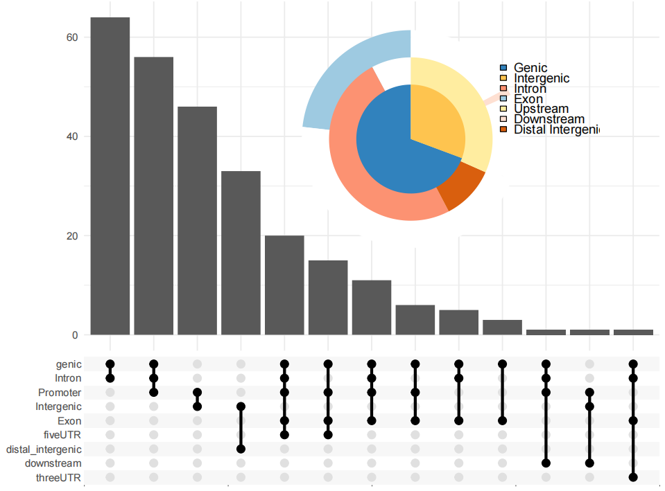
merge

Slide 10
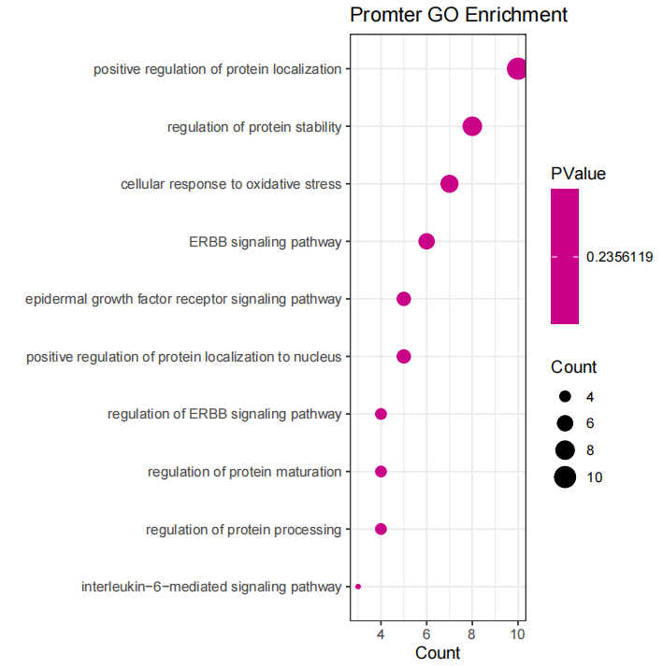

merge

